Slide 1
Stanford ME469: The Role of Mass Flow Rate
Stefan P. Domino
Computational Thermal and Fluid Mechanics
Sandia National Laboratories SAND2018-4536 PE

Slide 2

Advection Operators: Outline
The Advection Operator and the Role of $\dot{m}$
Pressure Stabilization Effects
Revisit the Projected Nodal Gradient

Slide 3
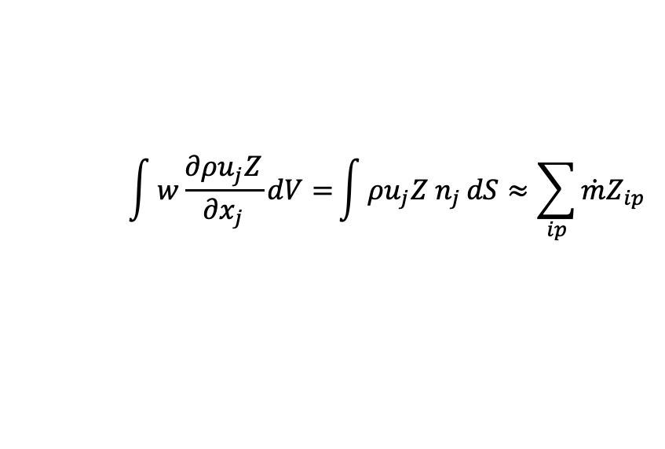
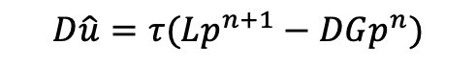
First, The Role of $\dot{m }$
For an equal-order, low-Mach approximate projection scheme, explicit pressure stabilization was added. How does this manifest itself in the advection operator?
Recall discrete continuity solve
$$\int{w\frac{∂ρu_{j}Z}{∂x_{j}}dV=}\int{ρu_{j}Z n_{j}}dS≈\sum_{ip}{\dot{m}Z_{ip}}$$
$$D\hat{u}=τ(Lp^{n+1}−DGp^{n})$$

Slide 4
First, The Role of $\dot{m }$
For an equal-order, low-Mach approximate projection scheme, explicit pressure stabilization was added. How does this manifest itself in the advection operator?
Recall discrete continuity solve
$$\int{w\frac{∂ρu_{j}Z}{∂x_{j}}dV=}\int{ρu_{j}Z n_{j}}dS≈\sum_{ip}{\dot{m}Z_{ip}}$$
$$D\hat{u}=τ(Lp^{n+1}−DGp^{n})$$
j-2
j-1
_{j-1/2}
j
_{j+1/2}
j+1
j+2

Slide 5
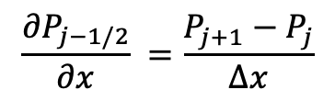
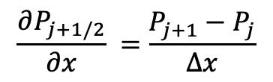
First, The Role of $\dot{m }$
For an equal-order, low-Mach approximate projection scheme, explicit pressure stabilization was added. How does this manifest itself in the advection operator?
Recall discrete continuity solve
$$\int{w\frac{∂ρu_{j}Z}{∂x_{j}}dV=}\int{ρu_{j}Z n_{j}}dS≈\sum_{ip}{\dot{m}Z_{ip}}$$
$$D\hat{u}=τ(Lp^{n+1}−DGp^{n})$$
$$\frac{∂P_{j−1/2}}{∂x} =\frac{P_{j+1}−P_{j}}{∆x}$$
$$\frac{∂P_{j+1/2}}{∂x} =\frac{P_{j+1}−P_{j}}{∆x}$$
j-2
j-1
_{j-1/2}
j
_{j+1/2}
j+1
j+2

Slide 6
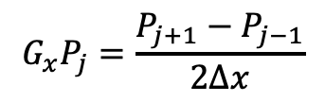
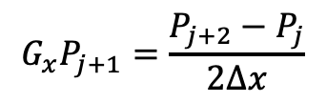
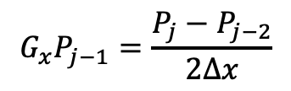
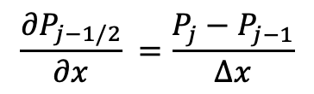
First, The Role of $\dot{m }$
For an equal-order, low-Mach approximate projection scheme, explicit pressure stabilization was added. How does this manifest itself in the advection operator?
Recall discrete continuity solve
$$\int{w\frac{∂ρu_{j}Z}{∂x_{j}}dV=}\int{ρu_{j}Z n_{j}}dS≈\sum_{ip}{\dot{m}Z_{ip}}$$
$$D\hat{u}=τ(Lp^{n+1}−DGp^{n})$$
$$\frac{∂P_{j−1/2}}{∂x} =\frac{P_{j}−P_{j−1}}{∆x}$$
$$\frac{∂P_{j+1/2}}{∂x} =\frac{P_{j+1}−P_{j}}{∆x}$$
j-2
j-1
_{j-1/2}
j
_{j+1/2}
j+1
j+2
$$G_{x}P_{j−1}=\frac{P_{j}−P_{j−2}}{2∆x}$$
$$G_{x}P_{j}=\frac{P_{j+1}−P_{j−1}}{2∆x}$$
$$G_{x}P_{j+1}=\frac{P_{j+2}−P_{j}}{2∆x}$$

Slide 7
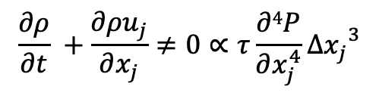
First, The Role of $\dot{m }$
For an equal-order, low-Mach approximate projection scheme, explicit pressure stabilization was added. How does this manifest itself in the advection operator?
Using the above equations, we can derive the actual continuity equation that we are solving:
Recall discrete continuity solve
$$\int{w\frac{∂ρu_{j}Z}{∂x_{j}}dV=}\int{ρu_{j}Z n_{j}}dS≈\sum_{ip}{\dot{m}Z_{ip}}$$
$$D\hat{u}=τ(Lp^{n+1}−DGp^{n})$$
$$\frac{∂P_{j−1/2}}{∂x} =\frac{P_{j}−P_{j−1}}{∆x}$$
$$\frac{∂P_{j+1/2}}{∂x} =\frac{P_{j+1}−P_{j}}{∆x}$$
j-2
j-1
_{j-1/2}
j
_{j+1/2}
j+1
j+2
$$G_{x}P_{j−1}=\frac{P_{j}−P_{j−2}}{2∆x}$$
$$G_{x}P_{j}=\frac{P_{j+1}−P_{j−1}}{2∆x}$$
$$G_{x}P_{j+1}=\frac{P_{j+2}−P_{j}}{2∆x}$$
$$\frac{∂ρ}{∂t} +\frac{∂ρu_{j}}{∂x_{j}}≠0∝τ\frac{∂4P}{∂x_{j}^{4}}{∆x_{j}}^{3}$$

Slide 8
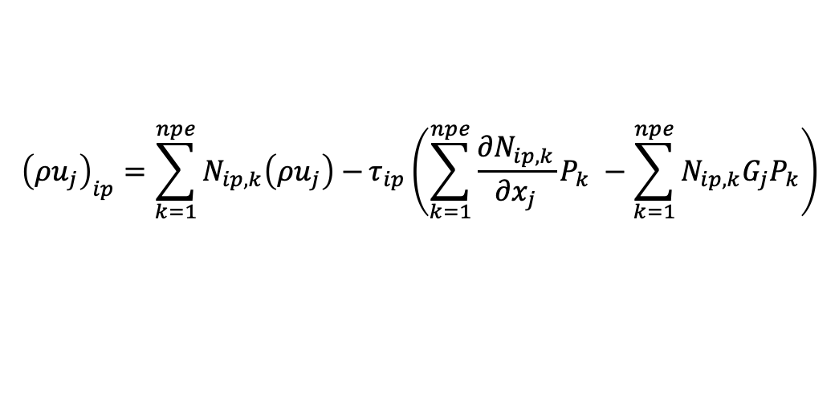
Now, the hard choice….
We have already seen that the continuity equation includes a fourth-order pressure derivative, at least when using the standard fine-scale momentum residual stabilization approach
Moreover, even order derivatives are stabilizing (suppresses growth via dissipation)
Two notions of velocity:
The nodal velocity whose divergence (in a uniform density flow) is proportional to the fourth-order pressure derivative
The integration point velocity, or convecting velocity, that includes the L-DG term
Inclusion of the pressure stabilization terms in the mass flow rate ensures that the DOF is conserved, however, in some parts of the literature, this is not clearly represented and sometimes these terms are dropped.
Inclusion of these pressure stabilization terms in momentum also provides a dissipative quality and, as such the system is not perfectly kinetic energy conserving, You et al., PoF, 2008, https://doi.org/10.1063/1.3006077
$${\left(ρu_{j}\right)}_{ip}=\sum_{k=1}^{npe}{N_{ip,k}\left(ρu_{j}\right)−}τ_{ip}\left(\sum_{k=1}^{npe}{\frac{{∂N}_{ip,k}}{∂x_{j}}P_{k}} −\sum_{k=1}^{npe}{N_{ip,k}G_{j}P_{k}}\right)$$

Slide 9
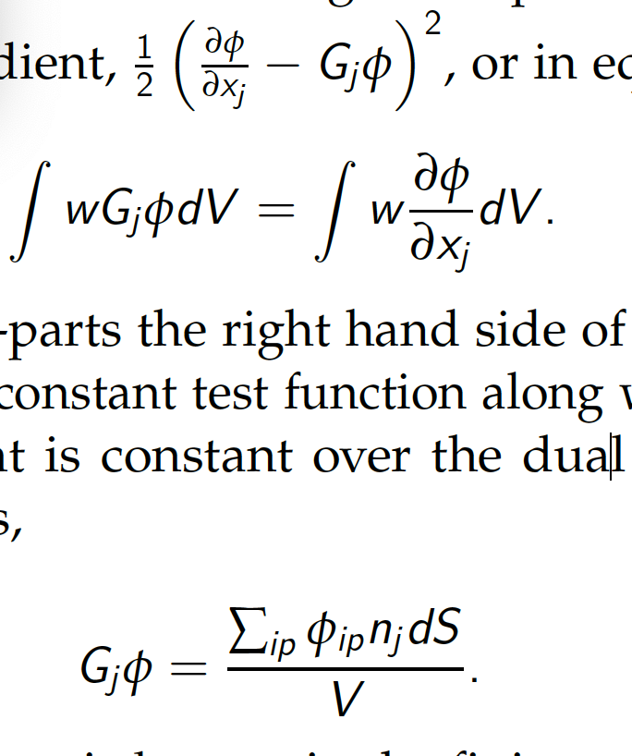
Re-visiting Nodal Gradient Operator: An Alternative View
Recall, that the edge- and element-based diffusion operator, and for some choices for the advection operator, and pressure stabilization, a nodal gradient is required
What is a nodal gradient? As formerly described in the Computing Gradients lecture, in a cell-centered context we obtained this via a number of ways, e.g., Green-Gauss, Least Squares, etc.
Let’s take another view…
First, the gradient of a function for ordinary finite element basis functions are discontinuous, i.e., the value at a shared element face depends on which element is used to compute the gradient
Therefore, we can view the nodal gradient a continuous at the nodes and discontinuous within the elements
Let’s minimize this difference:
by solving:
Lumped-mass

Slide 10
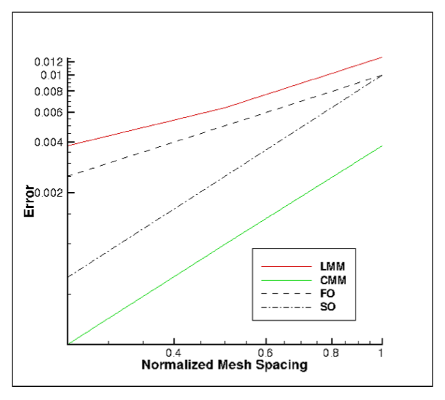
Re-visiting Nodal Gradient Operator: Convergence
On a Quadratic Unstructured Quad element, we see that second-order convergence of the projected nodal gradient is only noted when a consistent mass matrix is used (requires a matrix inversion, or an outer iteration for an explicit scheme)
Lack of design-order projected nodal gradients affect the design-order expectation for the DOFs velocity and pressure! No real extension of reconstruction schemes to higher-order

